Slide 1
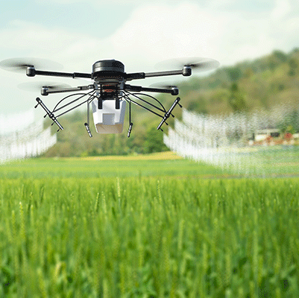
Pesticide-spraying drones in farming crops, and its contribution in sustainability
Presented by Tuan Khoi Nguyen - 1025294
Image source: Adobe Stock

Slide 2
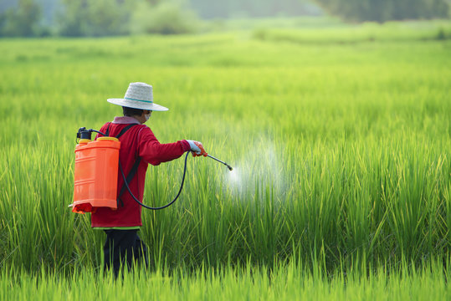
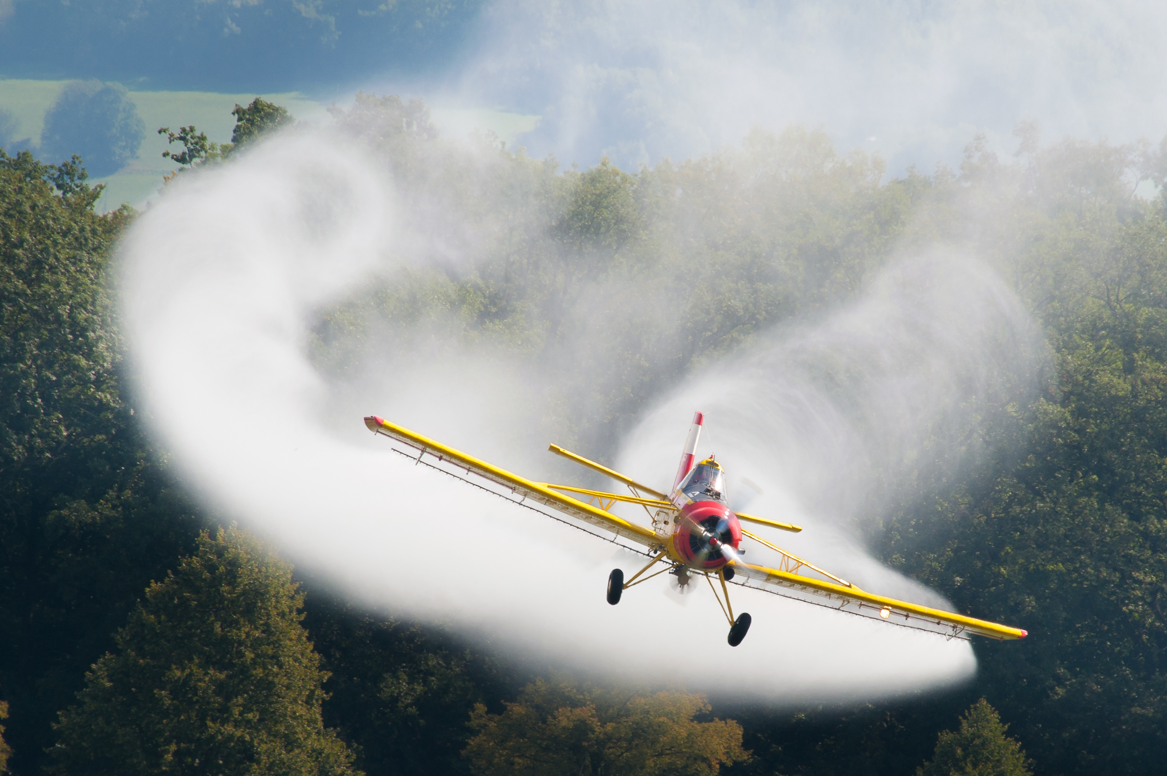
Existing pesticide spraying methods
Image source: Adobe Stock
Image source: Stefan Krause
Ground sprayers (human, spray vehicles):
High precision, easy manoeuvring
Cannot operate if soil is inaccessible (e.g. wet soil, dense crops, complex terrains) [3,5]
Exposure risk to worker’s health [1,5]
Aerial sprayers on planes and helicopters
Large coverage, time efficient [4]
Costly operation [5]
Requires large, flat area for landing/takeoff [5]

Slide 3
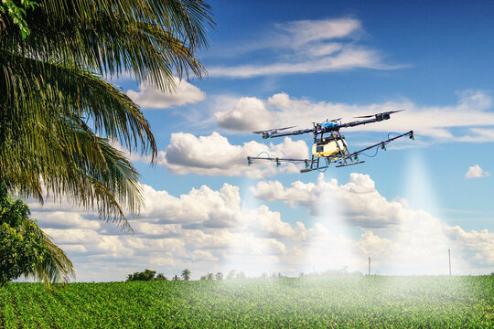
Spraying Drones
Handle complicated topologies [2,4,5]
More accurate on smaller fields [2,3]
Remotely controlled → Reduce health risk to workers [1,2,3]
Low-cost operation [5]
Can also inspect crops visually (e.g. tar spot detection) [5,6]
Image source: Adobe Stock

Slide 4




Sustainability development of spraying drones
Increase the quantity of healthy farm products
Reduce health risk due to chemical exposure and hunger
Potential of innovation in agriculture industry
Farm production pattern: maintain robustness to pests & diseases

Slide 5
Limitations
Operation efficiency:
Slow operation [5]
Short battery life: less than 30 minutes [1,2]
Ease of use:
Requires control fluency [4]
Each plant/chemical product requires different spraying procedures [5]
Flying restrictions in some areas [5]
→ Not good for large crops
→ Requires detailed knowledge before usage

Slide 6
Possible directions
Improve flexibility: adjustable to different conditions and requirements
Improve efficiency: tracking, reduce battery consumption, speed/spray rate optimization, etc.
User experience: make the drone easier to operate
Smart system: Combine extra functions that drone outputs (i.e. images) can bring

Slide 7
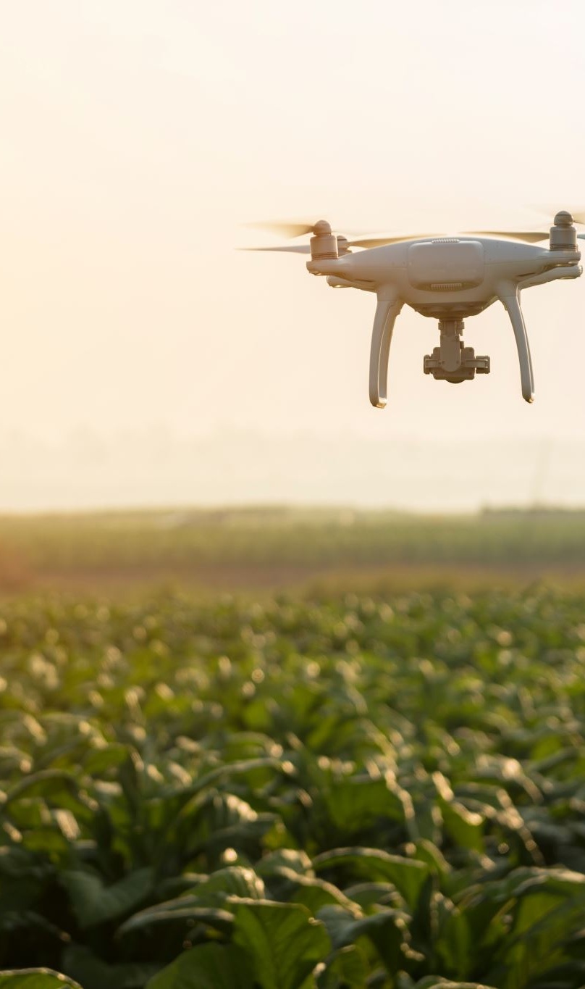
Conclusion
Spray drones has the potential to utilize in crops with small area or complex terrains, and is able to supplement traditional methods.
Spray drones contribute to UN SDGs 2, 3, 9 and 12 through improving the agriculture production.
Its current limitations hint possible development aims:
Capacity: process optimization
Expertise requirement: improve user-friendliness

Slide 8
References
[1] M. M. Vihari, U. R. Nelakuditi and M. P. Teja, "IoT based Unmanned Aerial Vehicle system for Agriculture applications," 2018 International Conference on Smart Systems and Inventive Technology (ICSSIT), Tirunelveli, India, 2018, pp. 26-28, doi: 10.1109/ICSSIT.2018.8748794.
[2] Spoorthi S., B. Shadaksharappa, Suraj S. and V. K. Manasa, "Freyr drone: Pesticide/fertilizers spraying drone - an agricultural approach," 2017 2nd International Conference on Computing and Communications Technologies (ICCCT), Chennai, India, 2017, pp. 252-255, doi: 10.1109/ICCCT2.2017.7972289.
[3] D. Yallappa, M. Veerangouda, D. Maski, V. Palled and M. Bheemanna, "Development and evaluation of drone mounted sprayer for pesticide applications to crops," 2017 IEEE Global Humanitarian Technology Conference (GHTC), San Jose, CA, USA, 2017, pp. 1-7, doi: 10.1109/GHTC.2017.8239330.
[4] X. Li et al., “Comparison of UAV and fixed‐wing aerial application for alfalfa insect pest control: evaluating efficacy, residues, and spray quality,” Pest Management Science, vol. 77, no. 11, pp. 4980–4992, Jul. 2021, doi: https://doi.org/10.1002/ps.6540.
[5] E. Ozkan, “Drones for Spraying Pesticides – Opportunities and Challenges”, 2023, URL: https://ohioline.osu.edu/factsheet/fabe-540

